Slide 1
DSA PROJECT PRESENTATION
TOPIC:-
STUDENT DATA MANAGEMENT
GROUP MEMBER’S :-
Venkatesh B.H
Rashad Ahmed
Niteesh Kumar
Vishal Nirney

Slide 2
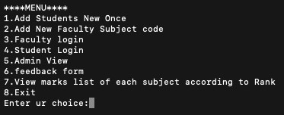
WELCOME TO PORTAL!!!

Slide 3
1) ADD STUDENTS
Storing the student info. using Hashtable (CHAINING) with roll no. as the key and the password of the student as a satellite data.
0
1
2
Roll No. | Password
Roll No. | Password
17IT132 | 132
/

Slide 4
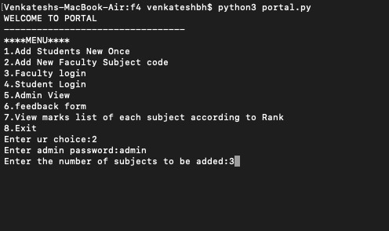
2) ADD NEW FACULTY CODE
In FACULTY.LST file , add subject code.

Slide 5
3) FACULTY LOGIN !!!!
Show the available subject code using QUEUES.
Add the final marks of the students based on their roll no.
Taking the Attendance of the students at respective day.
Finally display the attendance status of the student whose attendance has been previously recorded

Slide 6
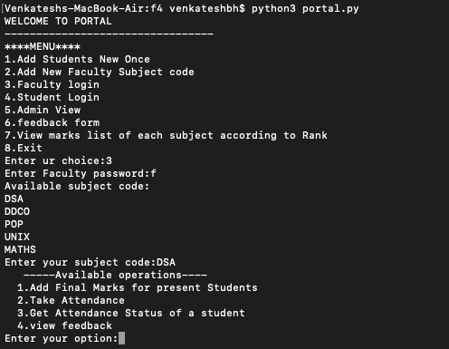

Slide 7
Available operations :-
Add final marks (of stored students).
Through the subject code entered a hashtable will be created of the same.
The student marks will be stored in the form of a doubly linked list through CHAINING.
This procedure uses the concept of INSERTION SORT.

Slide 8
2) TAKE ATTENDANCE :-
Enqueue absentees roll no. in the queue.
Do in-order traversal of the BST as shown below and check node(key) with the front of the queue.
If same , put absent for that roll no. and dequeue it else put as present for the same.
200
BATCH 2
BATCH 1
132
202
125
250

Slide 9
4) STUDENT LOGIN
Search through the hashtable for the required student using their respective roll no. and password.
Within the student login phase the option to change the password is also provided in case of need.
The roll numbers of the student are stored in a separate file named STDLIST.
0
1
2
17IT102
102

Slide 10
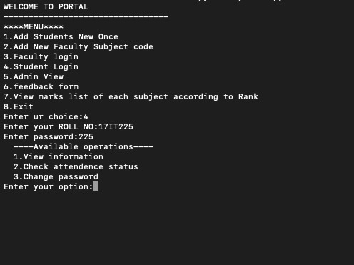

Slide 11
5) ADMIN VIEW
Through this portal the admin can view the various details of the students.
Exploration of specific student info is also possible using their roll no.
Details are received from the previous hashtable.
The admin the facility to change the password of the faculty.

Slide 12
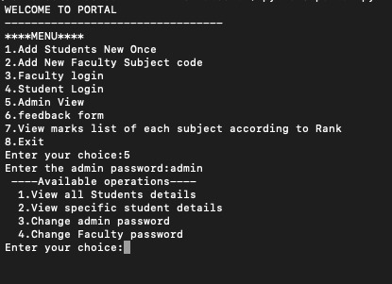

Slide 13
6) Feedback form
The feedback given by the student is stored in respective faculty file.
Whenever the faculty wishes to view it, he can do so through his respective feedback option using the subject code.
The feedback recorded is anonymous and will not reveal the identity of the student.

Slide 14
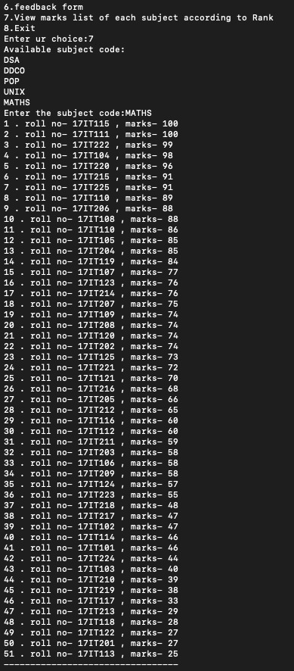
7) VIEW MARKS LIST
The marks list of various courses can be viewed using their respective subject codes.
The process involves dequeuing the subject codes and displaying the marks using the insertion sort technique.
The marks will be displayed in based on their rank.

Slide 15
8) eXIT
THANK YOU

